Slide 1
Interrupt Controller with Daisy Chain Priority
Ciomag Andrei Daniel
S.C. EasyIC Design S.R.L.

Slide 2
Daisy Chain Priority

Slide 3
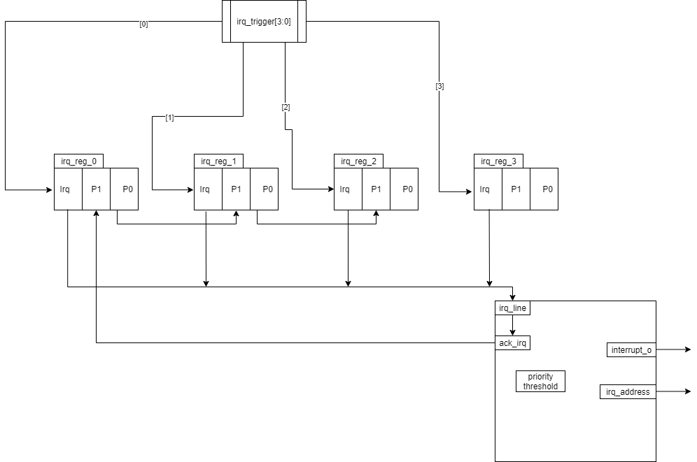
Implementation

